Slide 1


DESIGN AND DEVELOPMENT OF PUF FOR HARDWARE SECURITY UPDATE
DEPARTMENT OF ELECTRONICS ENGINEERING
MIT CAMPUS, ANNA UNIVERSITY
BATCH : 2022-2026
Presented by:
Navabharathi T (2022504526)
Dharshan R (2022504517)
Lakshmanan S (2022504310)
Guided by:
Dr. V. R. Vijaykumar,
Professor,
Department of Electronics Engineering,
Madras Institute of Technology,
Anna University.

Slide 2
CONTENTS
LITERATURE SURVEY
OBJECTIVE
BLOCK DIAGRAM
CURRENT STATUS
EXPERIMAENTAL MODIFICATIONS
RESULTS AND ANALYSIS
NEXT STEPS
WORK FLOW
REFERENCES

Slide 3
LITERATURE SURVEY
S.NO | AUTHOR | TITLE | JOURNAL DETAILS WITH YEAR | SIGNIFICANT CONTRIBUTION
1 | S. Hemavathy and V. S. Kanchana Bhaaskaran | “Arbiter PUF—A Review of Design, Composition, and Security Aspects ” | IEEE Access, vol. 11, pp. 33979–33993, 2023 | Inference: Provided a comprehensive review of Arbiter PUF designs, metrics, and their resilience against ML attacks. Many existing PUF architectures are still susceptible to deep learning and side-channel modeling.
2 | Sivappriya Manivannan, Rajat Subhra Chakraborty, Indrajit Chakrabarti, and Jothi Ramalingam | “Practical and Efficient PUF-Based Protocol for Authentication and Key Agreement in IoT” | IEEE Embedded Systems Letters, vol. 16, no. 2, pp. 118–121, 2024 | Inference: Proposed a lightweight authentication and key agreement protocol using Arbiter PUF, Fuzzy Extractor, and ECDH. Problem Identified: Conventional systems store large CRP sets or require pairing operations—both unsuitable for IoT.

Slide 4
LITERATURE SURVEY
S.NO | AUTHOR | TITLE | JOURNAL DETAILS WITH YEAR | SIGNIFICANT CONTRIBUTION
3 | Jim Plusquellic, Eirini Eleni Tsiropoulou, and Cyrus Minwalla | “Privacy-Preserving Authentication Protocols for IoT Devices Using the SiRF PUF” | IEEE Transactions on Emerging Topics in Computing, vol. 11, no. 4, pp. 918–931, 2023 | Inference: Developed COBRA and PARCE protocols using SiRF PUF that enhance privacy without leaking CRPs. Problem Identified: Conventional strong PUFs are vulnerable to model-building and response-leakage attacks.
4 | Fadi Farha, Huansheng Ning, Karim Ali, Liming Chen, and Christopher Nugent | “SRAM-PUF-Based Entities Authentication Scheme for Resource-Constrained IoT Devices | IEEE Internet of Things Journal, vol. 8, no. 7, pp. 5904–5914, 2021 | Inference: Proposed a lightweight SRAM-PUF authentication scheme suitable for low-power IoT devices. Problem Identified: SRAM-PUFs suffer from noise and entropy issues, especially under changing environmental conditions.

Slide 5

OBJECTIVE
To develop a robust Arbiter PUF using Verilog HDL.
To analyze the uniqueness of the Arbiter PUF by generating responses to multiple challenges and comparing the responses across different PUF instances.
To evaluate various PUF metrices such as Inter-chip variation, Intra-chip variation, uniformity, reliability and bit-aliasing.
To implement the developed Arbiter PUF in FPGA platform, focusing on validating its functionality.

Slide 6
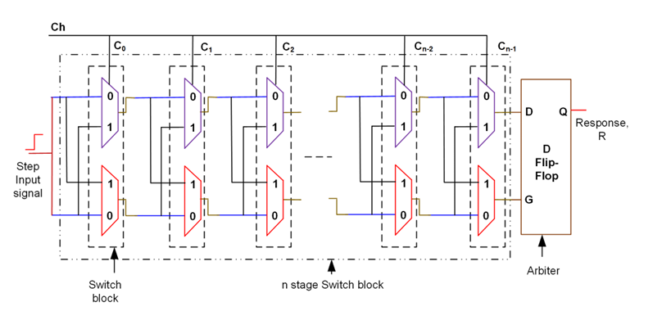
BLOCK DIAGRAM

Slide 7
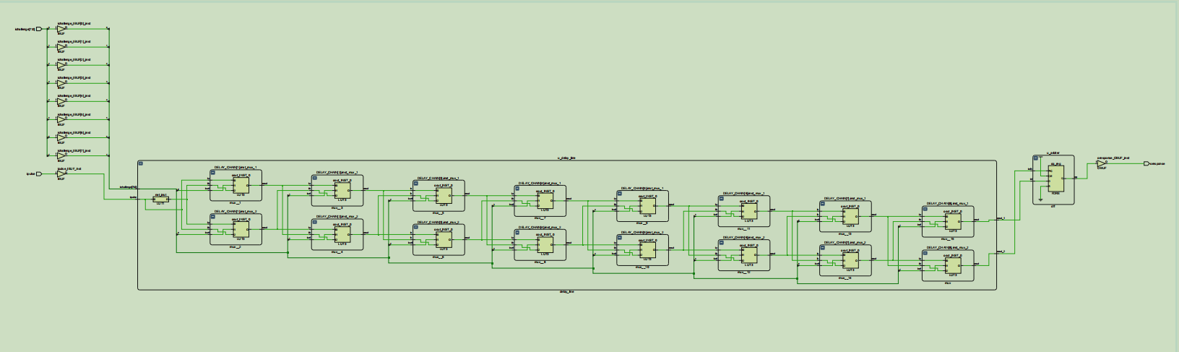
SCHEMATIC DIAGRAM

Slide 8
Current Status
Successfully implemented Arbiter PUF design on Basys 3 FPGA.
Verified stability of 87.5%, confirming high reliability across multiple test runs.
Attempted to enhance uniqueness using different interfaces and testing methods, achieving a uniqueness of 12.5%.
Observed that FPGA implementation stability is excellent, but uniqueness remains limited due to placement uniformity.
We are currently using Cadence software for ASIC synthesis.

Slide 9
Experimental Modifications
Explored Virtual Input/Output (VIO):
Purpose: Replace UART for direct hardware-level interaction and faster on-board testing.
Outcome: Enabled on-board challenge/response visualization and reduced dependency on PC serial communication.
Maintained UART integration for external logging and verification during previous tests.
Note: We did not increase the number of challenge inputs — experiments focused on interface/method changes only.

Slide 10
Results and Analysis
Stability: Maintained 87.5% response repeatability, showing minimal bit flips across trials.
Uniqueness: Efforts to increase inter-chip variation through VIO and interface modifications resulted in a uniqueness of only 12.5%.
Reason: Vivado’s automatic placement and routing tends to produce similar delay paths, limiting inter-device variation.
Conclusion: Achieved high reliability; uniqueness remains constrained by FPGA-level optimization.

Slide 11
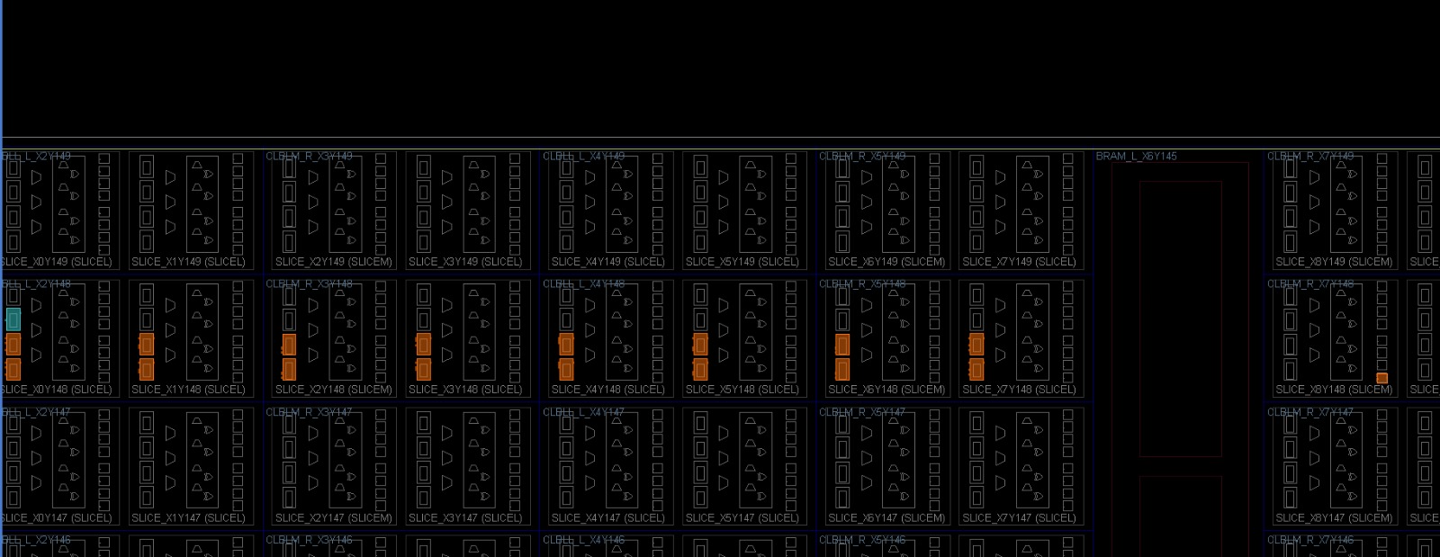
Results and Analysis
Placement of LUTs

Slide 12
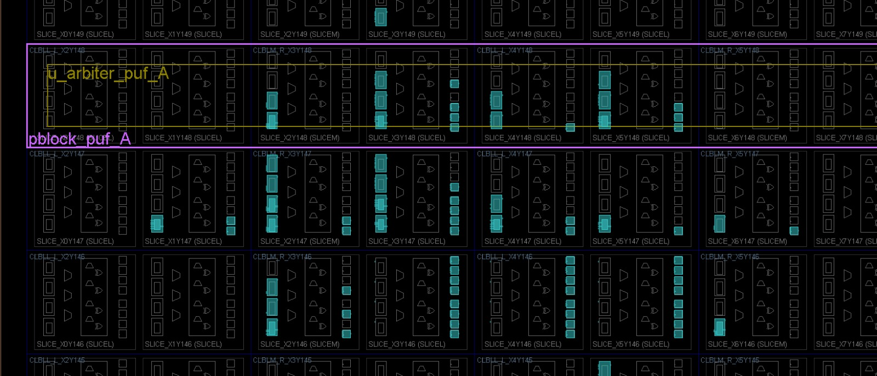
Results and Analysis
Creating Pblock, but LUTs Assigned Outside It

Slide 13
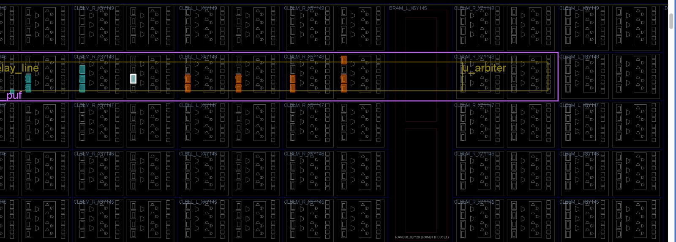
Results and Analysis
Complete Pblock with LUTs Placed Inside

Slide 14
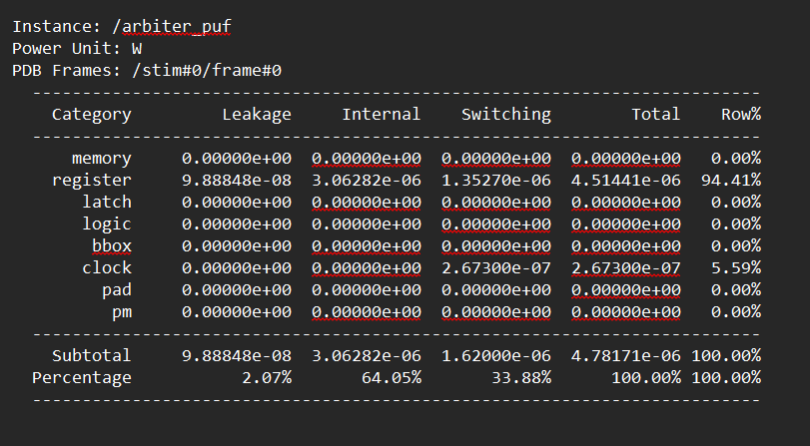
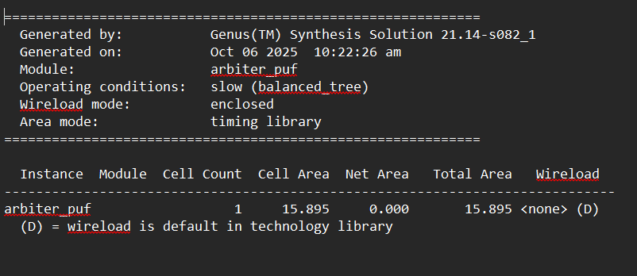
Results and Analysis
GENUS SYNTHESIS REPORTS

Slide 15
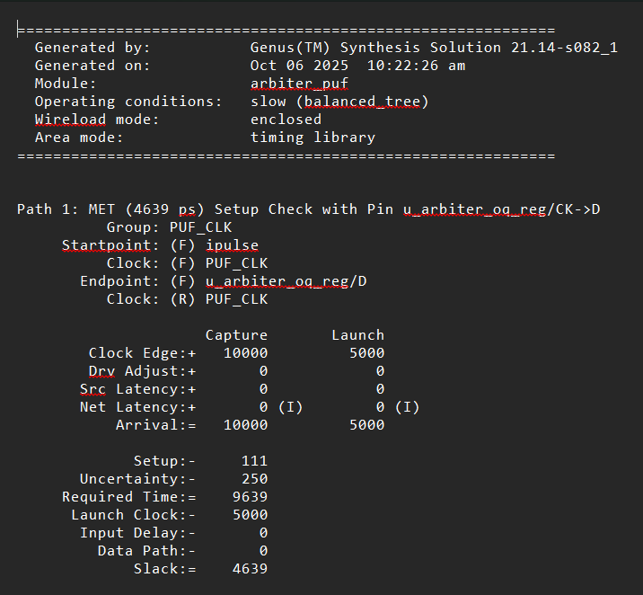
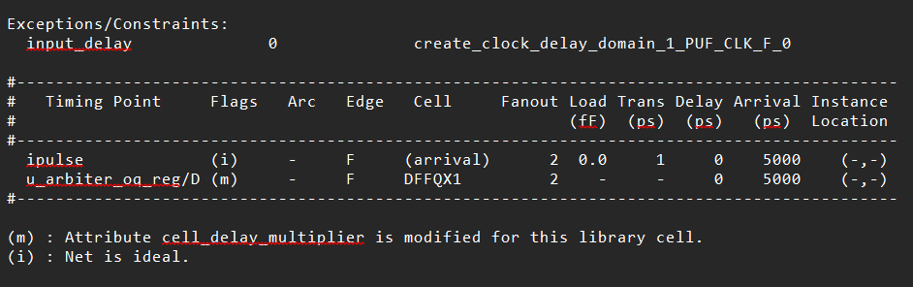
Results and Analysis
GENUS SYNTHESIS REPORTS

Slide 16
Apply manual floorplanning or routing constraints in Vivado to try to preserve physical delay differences.
Explore alternative PUF architectures (e.g., XOR Arbiter PUF, RO-PUF) or different FPGA families for improved uniqueness.
Perform environmental testing (temperature/voltage) to further evaluate robustness.
Prepare hardware demo and metric comparison table for the next review.
Next Steps
Apply manual floorplanning or routing constraints in Vivado to try to preserve physical delay differences.
Explore alternative PUF architectures (e.g., XOR Arbiter PUF, RO-PUF) or different FPGA families for improved uniqueness.
Perform environmental testing (temperature/voltage) to further evaluate robustness.
Prepare hardware demo and metric comparison table for the next review.

Slide 17
WORK FLOW
Review | Work to be Done
Review 1 | Implemented 8-bit Arbiter PUF in Verilog and verified functionality in Vivado with UART interface.
Review 2 | Collected Challenge-Response Pairs (CRPs) and analyzed PUF metrics — stability, uniqueness, reliability, and uniformity. Achieved 99 % stability and tested new communication methods (VIO interface). Observed that Vivado optimization limits uniqueness improvement.
Review 3 | Plan to enhance PUF uniqueness and stability using XOR-based architecture, manual placement / routing constraints, and post-processing techniques. Evaluate environmental robustness under voltage and temperature variations.

Slide 18
REFERENCES
J.Plusquellic and M.Areno,“Correlation-based robust authentication(cobra) using helper data only,” Cryptography, vol. 2, no. 3, 2018, Art. no. 21. [Online]. Available: https://www.mdpi.com/2410--387X/2/3/21
D.Heeger and J. Plusquellic, “Analysis of IoT authentication over LoRa,” in Proc. IEEE 16th Int. Conf. Distrib. Comput. Sensor Syst., 2020, pp. 458–465.
J.Plusquellic, “Shift register, reconvergent-fanout (SiRF) PUF implementation on an FPGA,” Cryptography, vol. 6, no. 4, 2022, Art. no. 59. [Online]. Available: https://www.mdpi.com/2410--387X/6/4/59
U. Rührmair et al., “PUF modeling attacks on simulated and silicon data,” IEEE Trans. Inf. Forensics Security, vol. 8, no. 11, pp. 1876–1891, Nov. 2013.
G. T. Becker, “On the pitfalls of using Arbiter-PUFs as building blocks,” IEEE Trans. Comput.-Aided Design Integer. Circuits Syst., vol. 34, no. 8, pp. 1295–1307, Aug. 2015.

Slide 19
REFERENCES(Cntd.)
Y. Wen and Y. Lao, “Enhancing PUF reliability by machine learning,” in Proc. IEEE Int. Symp. Circuits Syst., 2017, pp. 1–4.
H.Awano, T.Iizuka and M.Ikeda “PUF Net :A deep neural network based modeling attack for physically unclonable function,” in Proc. IEEE Int. Symp. Circuits Syst., 2019, pp. 1–4.
Y. Xu, Y. Lao, W. Liu, Z. Zhang, X. You, and C. Zhang, “Mathematical modeling analysis of strong physical unclonable functions,” IEEE Trans. Comput.-Aided Design Integer. Circuits Syst., vol. 39, no. 12, pp. 4426–4438, Dec. 2020.
J. Delvaux, “Machine-learning attacks on PolyPUFs, OB-PUFs, RPUFs, LHS-PUFs and PUF-FSMs,”IEEETrans.Inf.Forensics Security, vol. 14, no. 8, pp. 2043–2058, Aug. 2019.
Y. Lao and K. K. Parhi, “Statistical analysis of MUX-based physical unclonablefunctions,”IEEETrans.Comput.-AidedDesignIntegr.Circuits Syst., vol. 33, no. 5, pp. 649–662, May 2014.

Slide 20
THANK YOU

